Slide 1


Tools for Performance, Load Testing, Stress Testing Using Visual Studio
Snejina Lazarova
Dimo Mitev
Senior QA Engineer, Team Lead
Senior QA Engineer, Team Lead
CRM Team
SI Team
Telerik QA Academy

Slide 2

Table of Contents
Performance vs. Load vs. Stress Testing – Main Concepts
Performance Testing
Load Testing
Stress Testing
Visual Studio Testing Tools
Performance and Load Testing Using Visual Studio
Apache JMeter – Short Overview

Slide 3
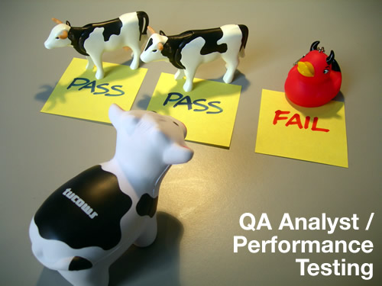
Performance vs. Load vs. Stress Testing
Main Concepts
Notes:
See: http://www.soapui.org/Load-Testing/concept.html
http://searchsoftwarequality.techtarget.com/answer/Understanding-performance-load-and-stress-testing
http://agiletesting.blogspot.com/2005/02/performance-vs-load-vs-stress-testing.html
http://agiletesting.blogspot.com/2005/04/more-on-performance-vs-load-testing.html

Slide 4
What are Performance, Load and Stress Testing?
Performance testing, load testing and stress testing are three different things done for different purposes
In many cases they can be done:
By the same people
With the same tools
At virtually the same time as one another
Still – that does not make them synonymous
Notes:
http://searchsoftwarequality.techtarget.com/answer/Understanding-performance-load-and-stress-testing

Slide 5

Perf. vs. Load – The Simplest Distinction
Performance Testing
How fast is the system?
Load Testing
How much load can the system process?
Stress testing
Testing with conditions beyond the normally expected ones
Under what conditions the system will fail?

Slide 6
Performance Testing (1)
What is Performance Testing?
Determines or validates the speed, scalability, and/or stability characteristics of the system
Provides stakeholders with information about the quality of the product or service under test
It is also the superset of other classes of performance-related testing
Such as load and stress testing
Notes:
http://searchsoftwarequality.techtarget.com/answer/Understanding-performance-load-and-stress-testing

Slide 7

Performance Testing (2)
The goal of performance testing is not to find bugs, but to:
Eliminate bottlenecks
Establish a baseline for future regression testing
Determine compliance with performance goals and requirements
Usually performed over a software that is already stable enough
Notes:
http://agiletesting.blogspot.com/2005/02/performance-vs-load-vs-stress-testing.html

Slide 8

Performance Testing Metrics
A variety of performance testing metrics is used in practice – e.g.,:
Requests Per Second
Bytes Per Second
Latency
Maximum Concurrency
Notes:
http://www.layer7tech.com/tutorials/performance-testing

Slide 9

Performance Testing Tools
Some popular tools for performance testing are:
Test Studio
JMeter
OpenSTA
Siege
ab
httperf
The Grinder

Slide 10
Core Performance Testing Activities
1. Identify Test Environment
2. Identify Performance Acceptance Criteria
3. Plan and Design Tests
4. Configure Test Environment
5. Implement Test Design
6. Execute Tests
7. Analyze, Report, and Retest
Notes:
http://msdn.microsoft.com/en-us/library/bb924359.aspx

Slide 11

Load Testing
What is Load Testing?
Testing performance characteristics of an application under specific volumes of load
Usually a range of the upper and lower limits expected by the business
Notes:
http://searchsoftwarequality.techtarget.com/answer/Understanding-performance-load-and-stress-testing
http://blog.browsermob.com/2008/12/performance-vs-load-vs-stress-testing/
See also: http://www.slideshare.net/orbitone/load-testing-web-applications

Slide 12
Goals of Load Testing
Load testing aims to improve:
Performance
Reduce the time needed to execute a request
Scalability
Exceed the number of concurrent users anticipated at peak load in production
Stability
Reduce component memory leaks and system crashes
Notes:
http://www.slideshare.net/orbitone/load-testing-web-applications

Slide 13
How to load-test a Web application
1. Identify performance acceptance criteria
2. Identify key scenarios
3. Create a workload model
4. Identify the target load levels
5. Identify metrics
6. Design specific tests
7. Run tests
7. Analyze the results

Slide 14

Load Testing Metrics
Many measurements can be used for load testing:
Average Response Times
Peak Response Times
Error Rates
Throughput
Requests per Second
Concurrent Users
Notes:
http://loadstorm.com/load-testing-metrics

Slide 15

Load Testing Tools
Open Source Tools
JMeter
ab
http_load
The Grinder
Siege
Commercial Tools
Test Studio
Load Runner (around $200,000 to own!)
Web Load
Third-party services

Slide 16

Stress Testing
What is Stress Testing?
Determining an application’s robustness, availability, and reliability
Under extreme levels of load
Testing while the product is subjected to other stressful conditions
E.g., limited memory, insufficient disk space or server failure
Notes:
http://msdn.microsoft.com/en-us/library/bb924374.aspx
http://blog.browsermob.com/2008/12/performance-vs-load-vs-stress-testing/
http://searchsoftwarequality.techtarget.com/answer/Understanding-performance-load-and-stress-testing

Slide 17
Stress Testing Techniques
1. Identify Objectives
2. Identify Key Scenarios
3. Identify Workload
4. Identify Metrics
5. Create Test Cases
Iterate
6. Simulate Load
7. Analyze Results

Slide 18

Goals of Stress Testing
Identify application issues that arise or become apparent only under extreme conditions
Heavy loads, high concurrency, or limited computational resources, etc.

Slide 19
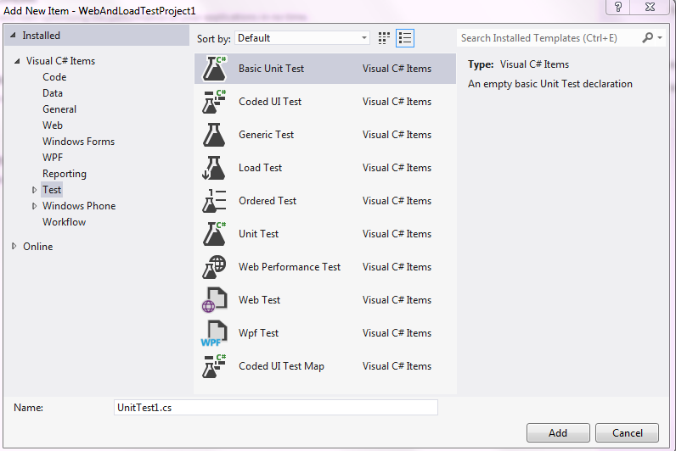

Visual Studio 2012 Testing Tools

Slide 20
VS Web Performance Tests
Used for testing functionality and performance
For web pages, web applications, web sites, web services, and combination of all of these
Can be created by recording the HTTP requests and events
During user interaction with the web application
The recording also captures:
Web page redirects, validations, view state information, authentication, etc.

Slide 21
Validation Rules
Validation rules are predefined criteria which the information contained in the response has to pass through
Used for validating the form field names, texts, and tags in the requested web page
We can validate the results or values against the expected result as per the business needs
Also used for checking the processing time taken for the HTTP request

Slide 22

Extraction Rules
Used for collecting the data from the web pages during requests and responses
Helps us in testing the functionality and expected result from the response

Slide 23
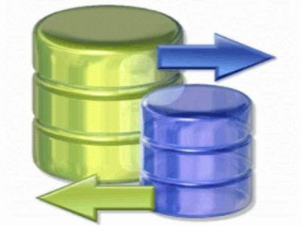
Data Driven Web Testing
Web Performance Tests require a data source
Used for populating data to the test methods
Could be a database, a spreadsheet, or an XML data source
Data binding mechanism
Takes care of fetching the data from the source and providing it to the test methods

Slide 24


Simple vs. Coded Web Tests
Web Performance Tests can be classified into:
Simple Web Performance Tests
Coded Web Performance Tests

Slide 25

Simple Web Performance Tests
Simple Web Performance Tests
Generate and execute the test as per the recording with a series of valid flows of events
Once the test is started there won't be any intervention and it is not conditional

Slide 26
Coded Web Performance Tests
Coded Web Performance Tests
More complex but provide a lot of flexibility
Used for conditional execution based on values
Can be created manually or generated with a web performance test recording tool
Using the generated code, we can control the flow of test events by customizing the code

Slide 27
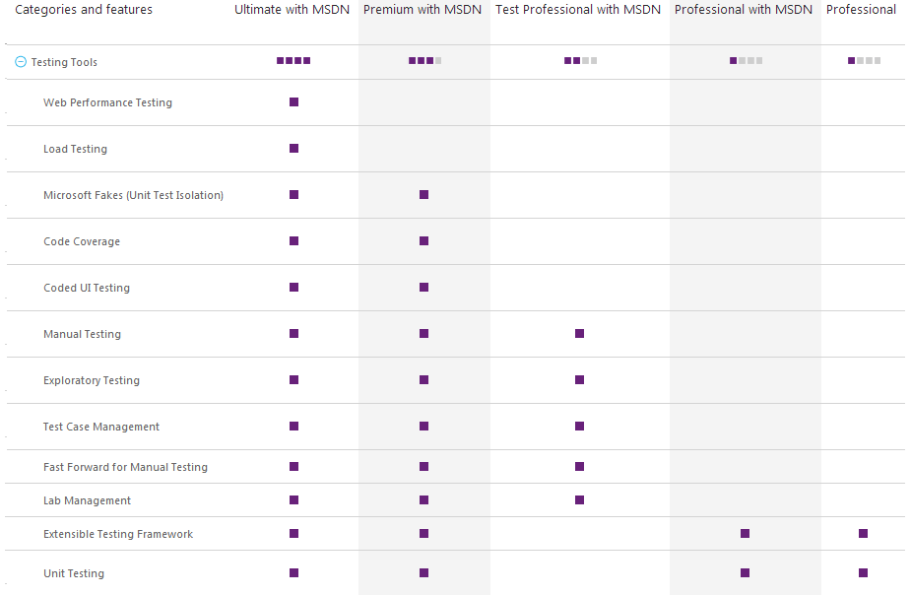
Visual Studio 2012 Testing Tools

Slide 28
Validation and Verification Test
Validation and verification test:
Helps to verify the inputs or the expected entries that satisfy the requirements
E.g., if a field requires a date to be entered, the system should check for the date validation
Should not allow the user to submit the page until the correct entry is made

Slide 29
VS 2012 Test Types

Slide 30
VS 2012 Test Types (2)
Visual Studio supports various test types to perform the test automation
Basic Unit Test and Unit Test
Helps in creating new Unit test for a class file
Helpful for both developers and testers to perform unit level testing
Coded UI test
Used for recording the UI activities of a manual test

Slide 31
VS 2012 Test Types (3)
Visual Studio supports various test types to perform the test automation
Generic Test
Used for wrapping an executable as a test method
You can wrap the executable using generic Test and can include the same in test automation

Slide 32
VS 2012 Test Types (4)
Visual Studio supports various test types to perform the test automation
Ordered test
Used for executing multiple test scripts in a particular order
Web Performance Test
Used for recording the URLs and generating the code for performance testing

Slide 33
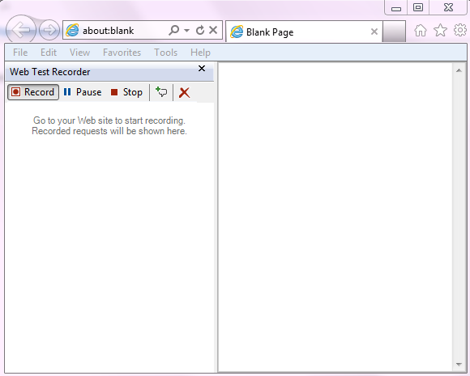
Creating Web Performance Test
Live Demo

Slide 34

Recording a Test
The web test recorder is used mainly to record all the actions performed while browsing web pages
Records all requests and responses
Helps us to find out if the request produces the expected result as per the requirement with different scenarios

Slide 35

Methods Used for Sending Requests
HTTP-GET (Hypertext Transfer Protocol-GET)
Appends the query strings to the URL
HTTP-POST (Hypertext Transfer Protocol-POST)
Passes the name and value pairs in the body of the HTTP request message

Slide 36
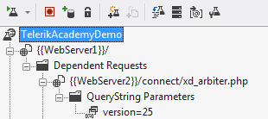
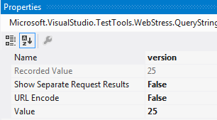
Query Strings
The Query string is the name and the value pair that is created out of the parameters and the data used in web testing

Slide 37
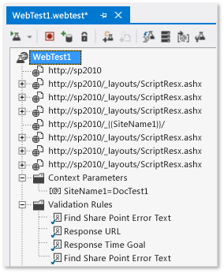
WebTest Editor
After completing all requests recording the results can be viewed and edited in the WebTest Editor

Slide 38
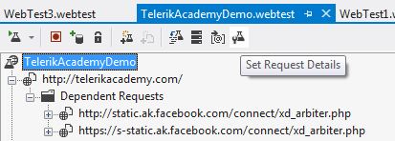
WebTest Editor (2)
The editor shows the tree view of all the requests captured during recording
Exposes the different properties of requests and the parameters for each request
Extraction and Validation rules can be set

Slide 39
Property Levels
There are different levels of properties that we can set using the WebTest editor on the recorded requests
WebTest root level
Request level properties
Properties for a request parameter
Setting the extraction and validation rules for the responses

Slide 40
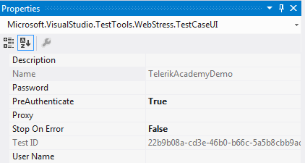
Web Test Properties
Applied to the entire Web Performance Test
Description
Name
User Name
Password
PreAutenticate
Proxy
Test ID
Stop On Error

Slide 41
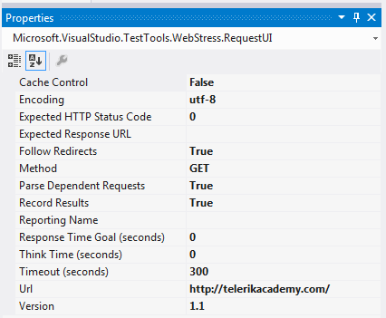
Test Request Properties
Request level properties apply to individual requests within the web test

Slide 42

Test Request Properties (2)
Test request properties:
Cache Control
Encoding
Expected HTTP Status Code
Expected Response URL
Follow
Redirects
Method
Notes:
Cache Control
This property is to simulate the caching property of the web pages.
The value can be true or false. If it is set to true, it means that caching is
turned on, which means that the dependent requests are retrieved only
once for subsequent requests. For example, an image file used in all the
web pages is retrieved from the source only once and kept in cache and
re-used for all further requests.
If we turn caching off, then the dependent requests are retrieved from
the source for every web page request. If it is an image, then the same
image file will be retrieved for every request even though it is the same
image. This property is very useful when testing performance by turning
the caching on and off. Based on the performance we can see whether to
cache the data or not.
This property is set to the main request but not to dependent requests of
the main requests. An image embedded within the web page is one of
the best examples of a dependent request.
The default value for this property is False.
Encoding
This is defaulted to utf-8 as most of the HTTP requests are utf-8
encoding. It can be changed if we need a different encoding for the texts.
Expected HTTP Status Code
We can set this to the expected status code for the request. For example, if we don't want this request to be found on the server then we set this value to 404. The error code 404 denotes that the resource cannot be found. The default is set to 0 which returns pass if the return status is in the 200 or 300 range and returns fail if the return status is in the 400 or 500 range.
Expected Response URL
This is set to the final URL response that we expect after the current request and redirects, if any, are made. This is to validate the response. The expected response is validated using the validation rule.
Follow Redirects
This is set to true or false based on whether we want to allow the page redirects made by the request to follow or not. If set to true, then the request continues to its redirected web page and verifies if the status is the code entered for Expected HTTP Status Code. If it is false, the redirects are not followed.
For example, if the value of the Expected HTTP Status Code is set to any value between 200 and 300, and the Follow Redirects is set to True, then the end result status of the request after all redirects should be a success.
Status code with 200 or 300 level is a pass while status level with 400 or 500 is a failure.
Method
This property is used to set the request method used for the current request. It can either be GET or POST.

Slide 43

Test Request Properties (3)
Test request properties:
Parse Dependent Requests
Record Results
Response Time Goal (Seconds)
Think Time(Seconds)
Timeout (Seconds)
Version
Url
Notes:
Parse Dependent Requests
This property can be set to True or False to parse the dependent requests within the requested page. For example, we may not be interested in collecting the details for the images loaded in the web page. So we can turn off the requests for loading images by setting this to False. Only the main request details will be collected.
We should not get confused with this property and the Cache control property. Cache is to disable the dependent requests after caching the first occurrence of the request, but this property is to completely switch off the dependent requests or to completely turn them on.
Record Results
This is a Boolean value which can hold true if the performance data has to be collected for this HTTP request. It is false if the data is not required to be collected
Response Time Goal(Seconds)
There are situations where users need the application to respond quickly without any delay. To test this scenario, we can set this property to the expected maximum response time and then test the pages to find out the ones which do not meet the requirement. This value is specified in seconds. The default value is 0, which means the property is not set
Think Time(Seconds)
This is set for the think time required by a user between pages. This is not the exact time that the user can spend thinking, but is a rough estimation. Also, this property is not very useful for the normal single user Web Performance Test. This is very useful in the case of a Load Test where we can predict the load including the think time of the user between the pages.
The recorder automatically records the think times at the same time as recording the test
Timeout (Seconds)
This is the expiry time for the request. This is the maximum time for the request to respond back. If it doesn't return within this limit, then the page gets timed out with an error.
Version
This is to set the HTTP version to use for the request, which can be 1.0 or 1.1. The default is 1.1 which is the normal or the latest of the HTTP versions.
Url
This is the URL address for the request.

Slide 44

Request Parameters Properties
Each request in the Web Performance Test has its own properties
There may be many dependent requests for each main request
We can get and set some properties even at the dependent request level

Slide 45

Form POST Parameters
All field entries made by the user in the web page are sent to the server as Form POST Parameters
After recording we can check the actual values of the parameters that were sent during the request
Name
Recorded value
URL
Value

Slide 46
Query String Parameters
Query String parameters are listed for requests using the Query String method
The properties are the same as with Form Post Parameters
There is an additional property - Show Separate Request Result
Used for grouping the requests based on the value of this query string parameter
Useful for Load Testing
The default value is False

Slide 47
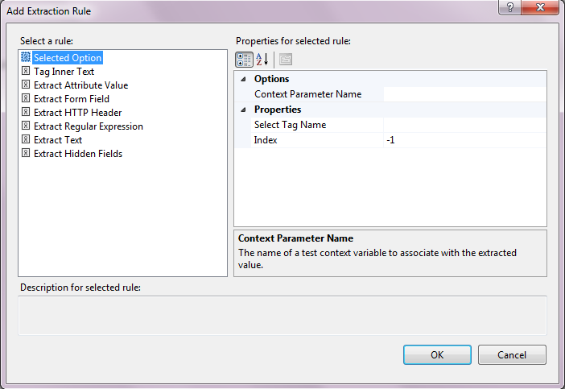
Extraction Rules in VS 2012
Extraction rules are useful for extracting data or information from the HTTP response
Visual Studio provides different options for extracting:
Values
Form fields
HTTP header
Еtc.

Slide 48
Extraction Rules in VS 2012 (2)
What can extracted values be used for?
As part of the next web request
Passing the values using query strings or values persisted in the View State object, or using Hidden fields
For making any business decisions
The extracted information can be stored in the context parameter and used globally across all requests following this

Slide 49
Types of Extraction Rules
Visual Studio 2010 provides several built-in types of extraction rules
Selected Option
Tag Inner Text
Extract Attribute Value
Extract Form Field
Extract HTTP Header
Extract Regular Expression
Extract Text
Extract Hidden Fields
Notes:
Tag Inner Text
To extract the inner text from the specified HTML tag. We can use the attribute name and value parameters to find the exact match of the attribute and then find the inner text from the matching attribute.
Extract Attribute Value
This is to extract the attribute value from the request page based on the tag and the attribute name; we can also use the optional matching attribute name and value within the same tag to find out the required attribute easily; the extracted value will be stored in the context parameter
Extract Form Field
This is to extract the value from one of the Form fields in the response; the field name is identified here
Extract HTTP Header
This is to extract the HTTP message header value in the response page
Extract Regular Expression
This extracts the value using the regular expression to find the matching pattern in the response
Extract Text
This is to extract the text from the response page; the text is identified based on its starting and ending value with text Casing as optional
Extract Hidden Fields
This extracts all hidden field values from the response and assigns them to the context parameter

Slide 50
Custom Extraction Rules
If we need additional extraction behavior we can create a custom extraction rule by deriving from the ExtractionRule class
Available in coded Web Performance Tests
We can add as many rules as we want, but should make sure that the Context Parameter Names are unique across the application

Slide 51


Dynamic Parameters
Most web applications generate data dynamically and send it via the Query String Parameter or Form Post Parameter to subsequent requests
E.g., the current user session ID

Slide 52
Dynamic Parameters
Web Performance Test can identify and detect dynamic parameters from the request response and then bind them to the other requests
Keeps track of the requests and finds the hard coded values, which can be replaced by dynamic parameters
This process is also known as Promoting Dynamic Parameters

Slide 53

Advantages of Dynamic Parameters
Different values can be passed in separate playbacks to the parameter and verify the test
Avoid playback failure
Due to passing the same values captured during the recording

Slide 54
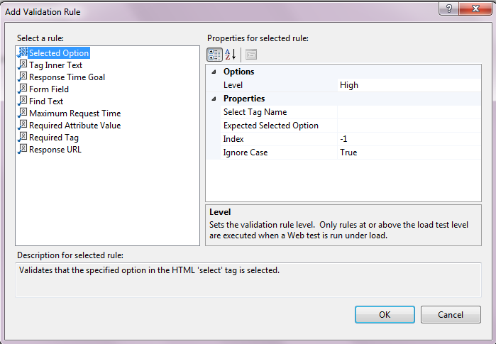
Validation Rules
Visual Studio 2012 provides a set of predefined rules for validations:
Selected Option
Tag Inner Text
Response Time Goal
Form Field
Find Text
Maximum Request Time
Required Attribute Value
Required Tag
Response URL
Notes:
Selected Option
Validates that the specified option in the HTML 'select' tag is selected. The parameters are:
Select Tag Name
Expected Selected Option
Index
Ignore Case
Tag Inner Text
Validates if the specified expected inner text exists within the specified HTML tag
Response Time Goal
Validates if the response time for the request is less than or equal to the response time goal as specified on the request
Form Field
The existence of the form field name and value is verified using this; the parameters are:
Form Field Name
Expected Value
Find Text
This is to verify the existence of a specified text in the response; the parameters used for this are:
Find Text
Ignore Case
Use Regular Expression
Pass If Text Found
Maximum Request Time
This is to verify whether the request finishes within the specified maximum request Time
Max Request Time (milliseconds)
Required Attribute Value
This is similar to the attribute used in the Extraction rules; in extraction rules we just extract the value of the specific attribute using the tag and the other attribute within the tag; but here in validation rules, we use the same tag to find out whether the attribute is returning the expected value; the parameters used here are the same as the ones used in extraction rules with an additional field to specify the expected value. The properties are:
Tag Name
Attribute Name
Match Attribute Name
Match Attribute Value
Expected Value
Ignore Case
Index
The index is used here to indicate which occurrence of the string to validate; if the index is set to -1, then it checks any form field value in the form and passes the test if any one match is found
Required Tag
To verify if the specified tag exists in the response; we can also set the minimum occurrence if there is a chance of getting the same tag many times in the response; the parameters are:
Required Tag Name
Minimum Occurrences
Response URL
This is to verify whether the URL is the same as the Expected URL; the property is the level for the response URL; the level can be High, Medium, or Low

Slide 55
The "Level" Parameter
As the number of validation rules grows, the performance or the time taken for the test will also grow
The Load Test performance is affected directly by the number of validation rules we have
In all the above rule types, we have a special parameter known as the Level that can be set to Low, Medium, or High

Slide 56
The "Level" Parameter (2)
Based on the Load Test property, the rules with the corresponding levels will get run during the Load Test:
Low
All validation rules with level Low will be run
Medium
All validation rules with level Low and Medium will be run
High
All validation rules with level Low, Medium, and High will be run

Slide 57
Transactions
Transactions are a set of operations or round-trips required to perform a particular operation
Defining transactions is helpful for analyzing the results of web testing
E.g., response time, response byte, etc.
Transactions will be displayed for each URL separately
Once defined, the transactions data will be displayed for the transaction level

Slide 58
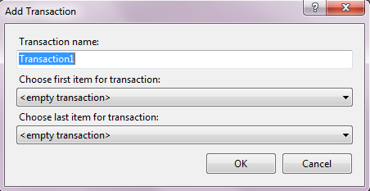
Transactions (2)
Grouping a set of activities
We simply need to state the starting request and the ending request for the transaction
All the requests in between will be part of the transaction, including these two requests

Slide 59

Correlation
Correlation is linking the response of one web request to the next web request
E.g., extracting, saving and passing SID values (as context parameters) for tracking web sessions

Slide 60
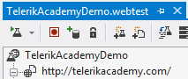
Toolbar Properties
The web test editor has a toolbar to work on the Web Performance Tests
Adding a data source
Setting credentials
Adding more requests recording
Adding plug-ins to the test
Generating code
Parameterizing web servers
Creating the performance session for the test

Slide 61
Parameterization
Parameterization is used for passing multiple values to the parameters
In test environment the input value will differ depends on the positive testing, negative testing, boundary testing, etc.
Values are picked from a data source
Data source can be a Database like SQL Server, Oracle and Excel, or data can be fetched from CSV or XML files too

Slide 62
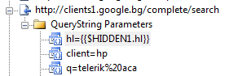
Context Parameters
Context parameters
Used like global variables
If you want to refer one parameter across all URLs, declare the same as context parameter
Should be referred inside double curly brackets
E.g., {{Webserver}}
All the URLs should be modified using the same context parameter

Slide 63

Performance Session
After running a test we only see the success or failure result of the test, and the different parameter values handled in the test
Performance session is used to get the actual performance of the functions or method calls
Also gets the time taken for all the methods within the test

Slide 64
Performance Session Types
Performance session allows four options for the session type:
CPU Sampling
Collects information such as the CPU time taken for the methods
Instrumentation
Used in cases where more information is collected from the test and the external programs are called within the test

Slide 65
Performance Session Types (2)
Performance session allows four options for the session type:
.NET Memory Allocation (Sampling)
Collects information like type, size, and number of objects created or destroyed, total bytes allocated to the objects
Concurrency
Used for collecting information about multithreaded applications

Slide 66
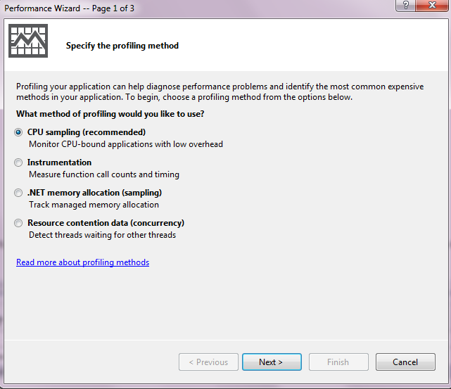
Running a Performance Session
Demo
Notes:
Book: Packtpub Software Testing using Visual Studio 2010 Dec 2010

Slide 67
Debug/Running Web Performance Test
After finishing a test, we can verify it by running it once to make sure it is working fine without any errors
There are different configuration files such as .vsmdi and .testsettings
They support the running and debugging of the Web Performance Test
These files are created automatically when we create a new test project

Slide 68
Roles
There are three different methods of test execution
Local execution
Run the test locally and collect the test execution data locally
Local execution with remote collection
Run the test locally and collect the data remotely
Remote execution
Run the test remotely and collect the data remotely

Slide 69
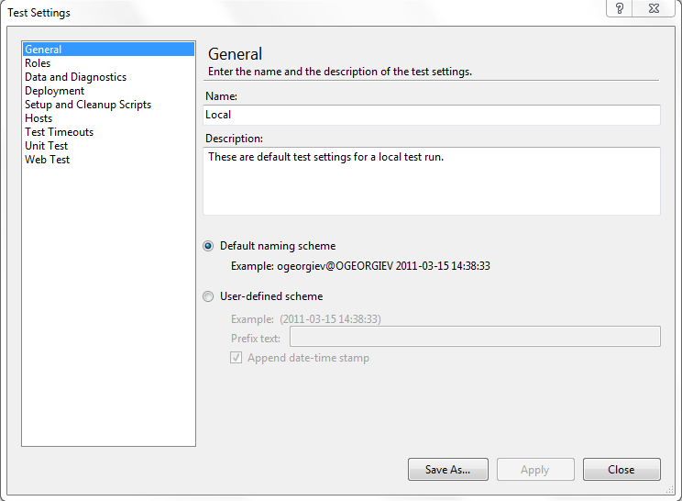
Test Settings
Quick Demo

Slide 70
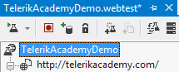
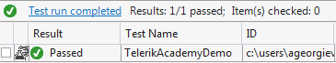
Running the Test
Use the Run Test option in the Web Performance Test editor toolbar to start running a test

Slide 71
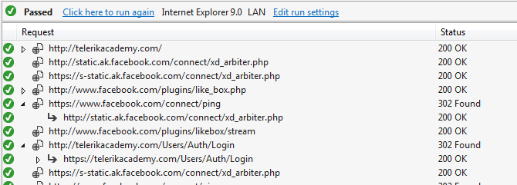
Running the Test (2)
After completing the execution, the result window displays success and failure information and marks against each request
If any one of the requests in the test fails, the entire test is marked as failed

Slide 72
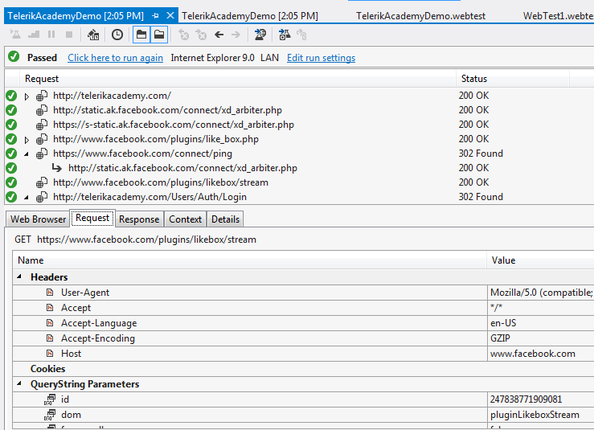
Running the Test (3)
Main elements
Web Browser
Requests
Response
Context
Details

Slide 73
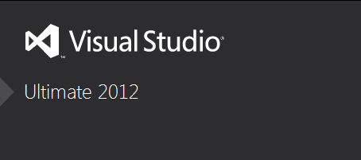
Load Testing Using Visual Studio 2012
Notes:
http://www.dotnetfunda.com/articles/article901-web-performance-test-using-visual-studio-part-i-.aspx
http://blogs.msdn.com/b/willy-peter_schaub/archive/2010/04/01/visual-studio-2010-performance-testing-quick-reference-guide-has-been-updated.aspx

Slide 74
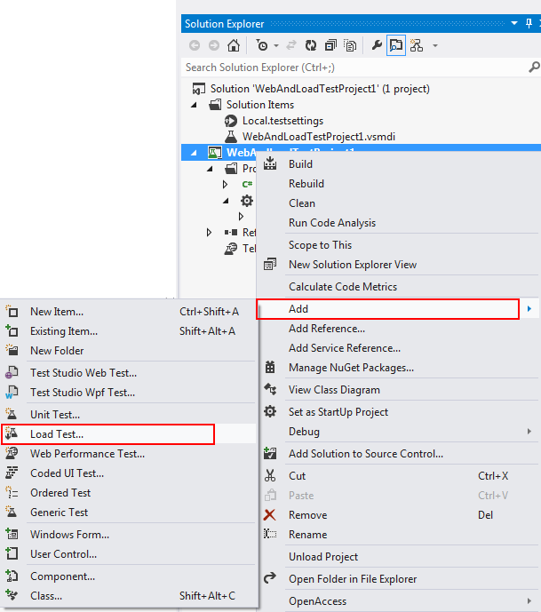
Load Test Wizard
Load Tests are created using the Visual Studio Load Test Wizard
A test project should be created first
Then the new Load Test is added
This opens the wizard and guides us to create the test

Slide 75
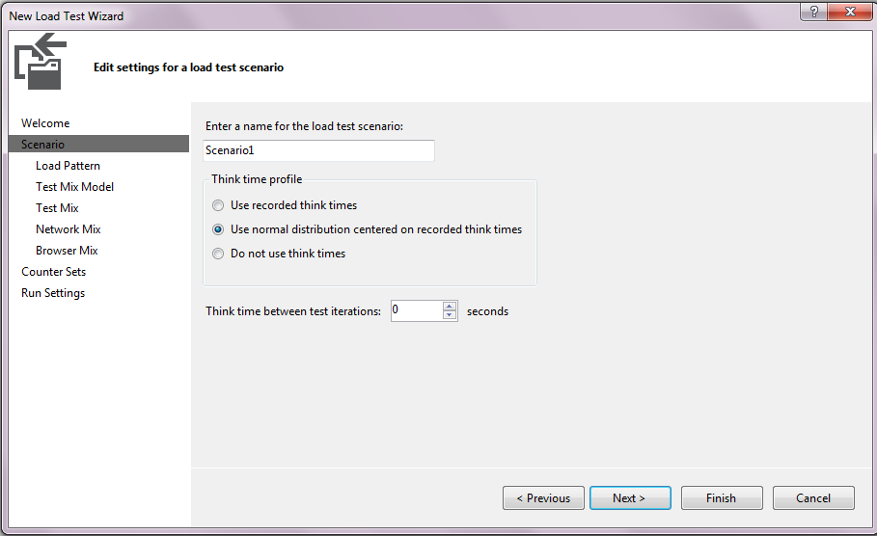
Specifying a Scenario
Scenarios are used for simulating actual user tests with predefined parameters:
Think Time
Load Pattern
Test Mix model
Test Mix
Network Mix
Browser Mix

Slide 76
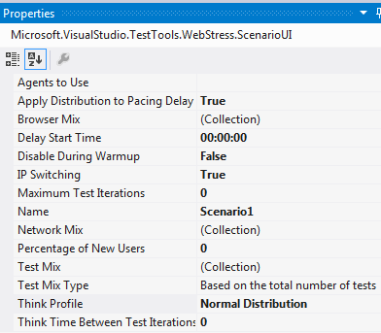
Editing Load Tests
The load can contain one or more scenarios for testing
The scenarios can be edited any time during the design

Slide 77
Running a Load Test
Load Tests are run like any other test in Visual Studio
Visual Studio also provides multiple options for running the Load Test:
Test View window
Test List Editor
Inbuilt run option in the Load Test editor toolbar
Command line command

Slide 78
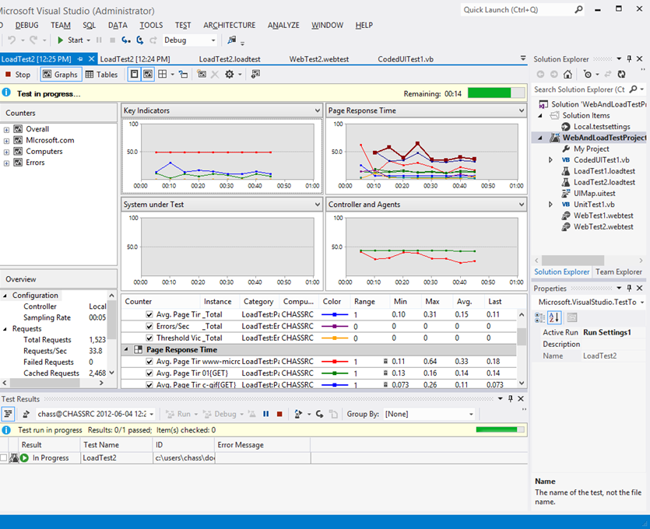
Working With Test Results
All test results get stored in the results repository store
There are different ways to see the test results:
Graphical view
Summary view
Table view
Details view

Slide 79
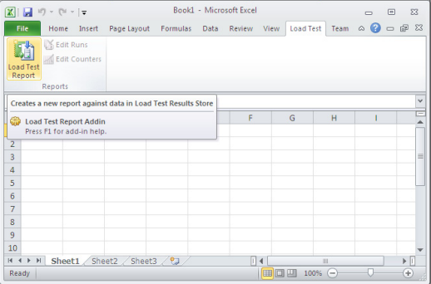
Exporting to Excel
Results from load testing can be exported to Excel
Use the Create Excel Report option in the toolbar of the Load Test result editor

Slide 80
VS Load Test
VS Load test uses a set of computers which consist of:
Controller
The central computer which controls multiple agent computers
Agents
The computers at different locations used for simulating different user requests

Slide 81

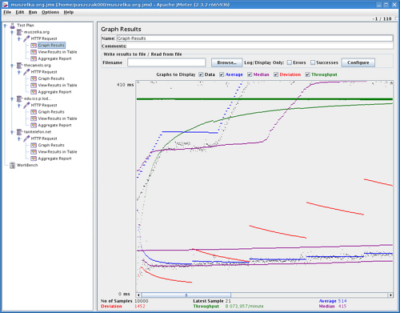
Apache JMeter
Short Overview
Notes:
See: http://www.slideshare.net/silenceit/apache-jmeter
http://www.slideshare.net/agoucher/performance-testing-with-jmeter
http://jakarta.apache.org/jmeter/
http://wiki.apache.org/jakarta-jmeter/JMeterLinks
http://en.wikipedia.org/wiki/Jmeter
http://jakarta.apache.org/jmeter/usermanual/index.html

Slide 82
What is Jmeter?
What is JMeter?
An Apache Jakarta project
A free, open-source performance measurement tool written in Java
Can be used as a load testing tool for analyzing and measuring the performance of a variety of services
With a focus on web applications
http://jakarta.apache.org/jmeter/
Notes:
http://www.slideshare.net/agoucher/performance-testing-with-jmeter
http://en.wikipedia.org/wiki/JMeter

Slide 83
Performance, Load Testing, Stress Testing
?
?
?
?
?
Questions?
?
?
?
?
?
?

Slide 84
Exercises
Exercise 1 - Login to www.telerik.com, go to your profile and update your data, save and verify, then RESTORE to original values and logout.
Exercise 2 – go to http://www.telerik.com/community/forums.aspx and perform search using data source (max 5 items), verify the results

Slide 85
Exercises
Go to http://msdn.microsoft.com/en-us/library/aa337591.aspx and make the steps for Creating a Web Performance Test that Requires a Login and Logout.

